Slide 1
March 2017 – Monthly Training Webinar 10 Ways to automate your social media posts for more buzz and visibility

Slide 2
Numbers Game
1,000 million English speakers (375 million speaking English as a first language)
1.71 billion active monthly Facebook users all over the globe
540 million Google+ users
500 million Instagram users
450 million LinkedIn users
313 million Twitter users
72.5 million Pinterest users
Note: these are figures as at the end of 2016 and are to give an indication only

Slide 3
It’s not the number of users of the networks that matters, however: It’s the breakdowns that determine whether or not a particular social network is your perfect strategy.
Think:
Who is your ideal client?
What platform are they using?
When are they using it?
What are they using it for?

Slide 4
Social automation alone is not some magical catch-all solution. You need to use it wisely as part of your lead generation and reputation-building strategy—not as a substitute for it.
You need to use it as part of a plan.
(Remember your social media plan is part of your marketing plan, which is part of your business plan!)

Slide 5
Which platforms?
Start out by calculating where the highest active concentration of your target market likes to congregate. You can do this by browsing stats via Google.
Enter into google: best times to post [insert name of platform] 2017 and see what comes up

Slide 6
Use the Insights or Stats reports provided by the social media sites on which you have a presence and find out the most active time for your particular group of followers and friends.

Slide 7
Analytics
You may find they either collaborate the general stats … or you may find that with your particular audience, the optimal time frame is completely different!
You’ll also find most native social analytics will give you stats about countries from which your visitors click through; how many clicks a particular post got; whether or not the visitor was on a mobile; and many more useful details.
Don’t just look at stats, however: Keep a log or make an MS Excel or MS Word spreadsheet and note down different trends and patterns.
Schedule time to do this each month

Slide 8
Do’s and Don’ts
DO…
Decide how much time you can commit daily to social media and take action
Respond to comments, questions and acknowledgements as soon as you can
Check posts you make within half an hour for any responses, after posting
Look for automation options that allow you input and customization
Be Social – be human
DON’T
Automate ALL your social media, ALL the time … OR …
Make automated posts that sound commercial and spammy

Slide 9
Step one: Use a browser news aggregator to automate feed delivery

Slide 10
Making powerful use of social media means READING and INTERACTING with social posts, as well as making them.

Slide 11
Use a Browser News Aggregator
It means keeping up with the official blogs for your top platform, as well as any authority blog you want to follow. And the easiest and most efficient way to do this, rather than visiting site after site, is to install a browser news aggregator.
An RSS aggregator allows you to bookmark articles for later, find feeds you need quickly, and even email feeds—all in a fracture of the time you might normally do this.

Slide 12
Why you use a browser aggregator
Keep you focused
In reducing stress from overwhelm
Eliminate distractions
Save time
Follow top influencers easily
Be consistent in your daily social media habits
Keep on top of the latest trends, news and developments in:
Social media
Influencers, peers and competitors you follow
Your niche

Slide 13
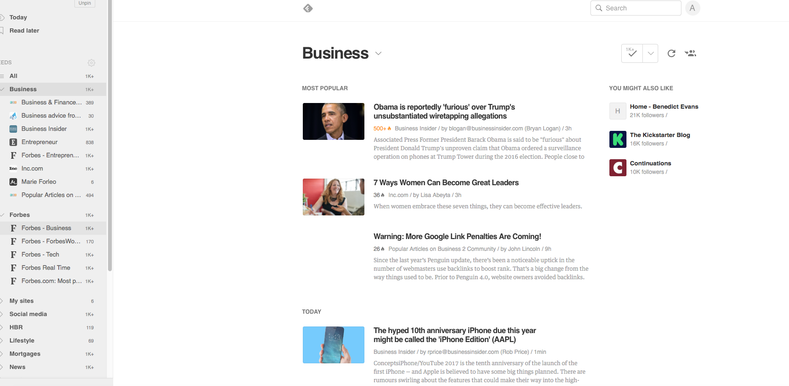
Use a Browser News Aggregator to Automate Feed Delivery
Recommended tool: Feedly

Slide 14
Use a Browser News Aggregator to Automate Feed Delivery
Blogs
Collections
Keyword alerts
Favorite online magazines
YouTube channels

Slide 15
Task: Blog List
Before you sign up to Feedly (or another RSS tool) – make a list of specific blogs that you want to follow (just the URLs)

Slide 16
Click on the green “Get Started for Free” button. Your login network of choice will ask to view your email address and basic profile info for that network. Grant permission.
In the left-hand sidebar, you will see “My Feedly”. You can then go through categories to select feeds—or you can add your favorite blogs by pasting the URL in directly.

Slide 17
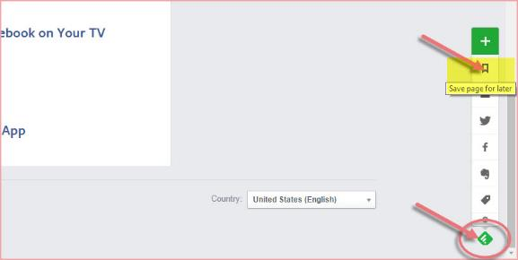
If you’re looking at an interesting article, and you want to table it to read later, or add a blog—just look for the little RSS icon in the bottom right corner of that blog page.
Click on the little green or grey diamond … and a popup menu will, well, pop up.

Slide 18
Subscribe to blogs
You can also subscribe to a blog or website feed by clicking on the little reverse-WiFi icon in the top right of their header or above their menu bar.

Slide 19
Step two: use buzzstream to research and reach influencers and connect

Slide 20
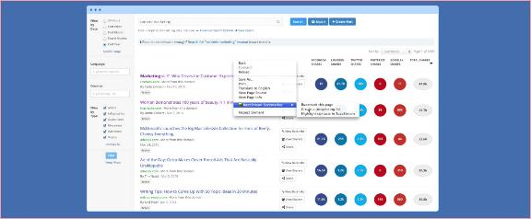
Use BuzzStream to Research and Reach Influencers and Connect
Instead of generating keywords, it mines social sites and blogs to find opportunities to guest post, connect, get quotes from influencers, etc.) The value is huge for those who rely on social networking for promotion and lead generation.

Slide 21
Step three: use wordpress plugins to automate your social media actions and content

Slide 22
Use WordPress Plugins to Automate Your Social Media Actions and Content
Creating customized “Share” and “Follow” buttons
Sharing specific pages
Displaying selected social streams
Displaying videos or portfolios

Slide 23
Use WordPress Plugins to Automate Your Social Media Actions and Content
The Onlywire bookmark and share button plugin - an automation plugin that allows you to submit content to mainstream social networks such as Facebook, Twitter, Google+ and many others.

Slide 24
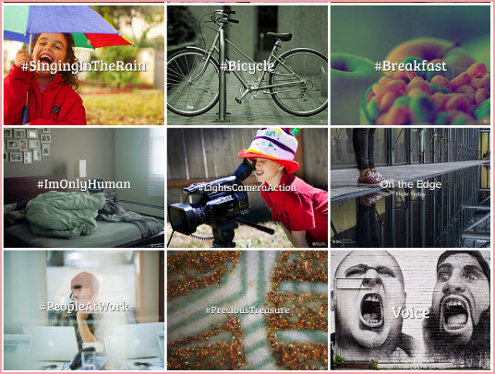
Another different type of plugin you’ll find in the WordPress plugins directory is Social Media Gallery, which allows you to display your visual streams on your website.

Slide 25
Step four: use widgets to speed up social sharing and create embedded social content

Slide 26
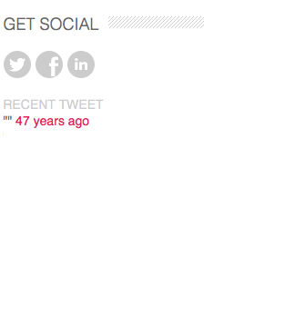
Use Widgets to Speed Up Social Sharing and Create Embedded Social Content
You can also install all sorts of other widgets like booking forms, calendars, time zone converters—but widgets excel at helping you share your best streams of social interaction.
If you are going to do this – ensure it’s a platform where you are active!

Slide 27
Use Widgets to Speed Up Social Sharing and Create Embedded Social Content
Most of your top social networks and content platforms allow you to install their widgets: After all, it’s good publicity for them too!
Look in the Help or Support areas, or search using the parameters [social network name] [widget]
Widgets add an interactive layer to your website—essential in today’s internet climate—as well as highlighting your most valuable assets such as testimonials, reviews or social sharing.
But use only if you are active!

Slide 28
Step five: think seasonally!

Slide 29
The Seasons!
Strategy is a big part of successful social planning—and a powerful way to increase your audience.
When you plan your social media campaigns for the upcoming year, think seasonally.

Slide 30
Days of the Year!
Days Of The Year aims to bring all of the world’s weird, funny, wonderful and bizarre holidays under one roof, and to create the ultimate guide to celebrating each and every day.
https://www.daysoftheyear.com

Slide 31
Step six: outsource your social sharing

Slide 32
Social media engagement is one of the most important ways to grow your reputation and your reach.

Slide 33
Step seven: maximize your social media engagement with content curation tools

Slide 34
Content Curation Tools
Tools to look at: Post Planner / Quuu / Hootsuite
“A Facebook page management tool that helps automate the sharing of content to your Facebook page. There is a content discovery engine which allows you to discover the most popular content in your industry and then you can add it to a queue for later delivery.”
They operate on a queue system, automatically posting based on pre-configured times.
Highly versatile social media engagement apps, allowing you to expertly find and curate content targeted to your ideal follower.

Slide 35
Step eight: update your social sharing buttons!

Slide 36
Update Your Social Sharing Buttons!
On your social media / website have social sharing buttons encouraging others to follow / share your content:
Customize and brand
Reposition, resize and colorize
Not just share, but follow and related post buttons too
Add individual buttons

Slide 37
Step nine: use mobile social apps

Slide 38
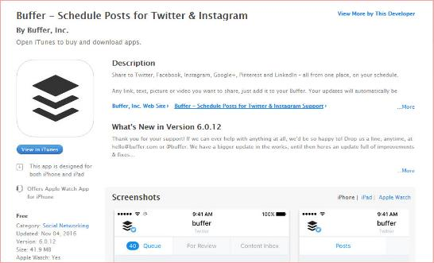
Use Mobile Social Apps
Hootsuite / Buffer all have app versions

Slide 39
Step ten: don’t take your automation for granted!

Slide 40
Do keep in mind that, for maximum effectiveness, you need to create a social media plan first—and make sure you select only apps, tools and strategies that make your plan work even more easily and powerfully.
Automating your social media posts should be a supportive strategy—not your only social strategy. When it comes to relationship building, nothing beats being there and having a real conversation!

Slide 41
Top Tips
Customize Your Automated Posts for Each Social Network
Schedule Your Posts Before You Go on Holiday
Pre-Post About Your Holiday
Automate Post Content Creation—but Don’t Automate Interaction
Use Content Creation Wisely
Fill the Gaps!
Never Automate Direct Messages

Slide 42
Tips Cont’d…
Don’t Automate ‘High-stakes’ Content
Forget the Words ‘Set and Forget’!
Do Make Use of Notifications
Check In Once A Day on All Your Social Networks
Find Out When Your Audience is at the Party (ie when do they engage with you)
Create Seasonal Posts in Advance and Pre-Schedule
Never Make Automation a Substitution for Engagement

Slide 43
Tips Cont’d…
Make the Most of Your Posts!
Pay Attention to Social Post Lifespans
Use Automation to Create Reminders
Include a Share Request in Reminders and Other Automated Posts
Monitor Your Social Posts
Keep a Social Automation Journal
Don’t sound like a Robot!

Slide 44
Q&A Session

